Slide 1
WARNING
These slides are not optimized for printing or exam preparation. They are for lecture delivery only.
As these slides contain a lot of animations, watch in slideshow mode for optimal results.

Slide 2
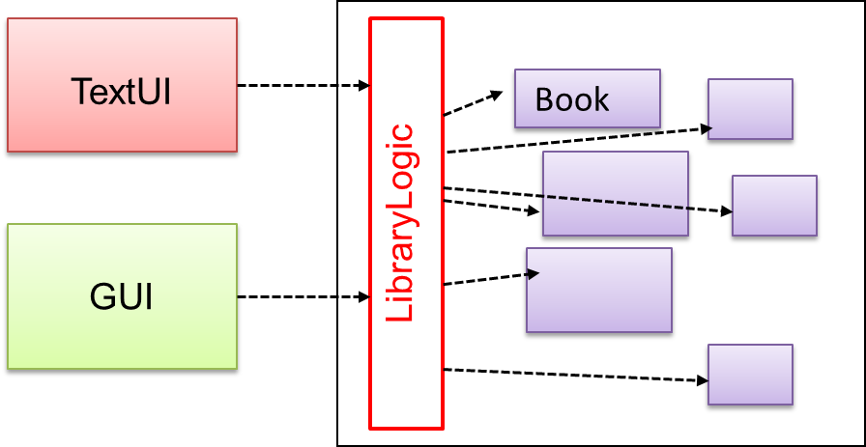
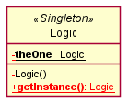
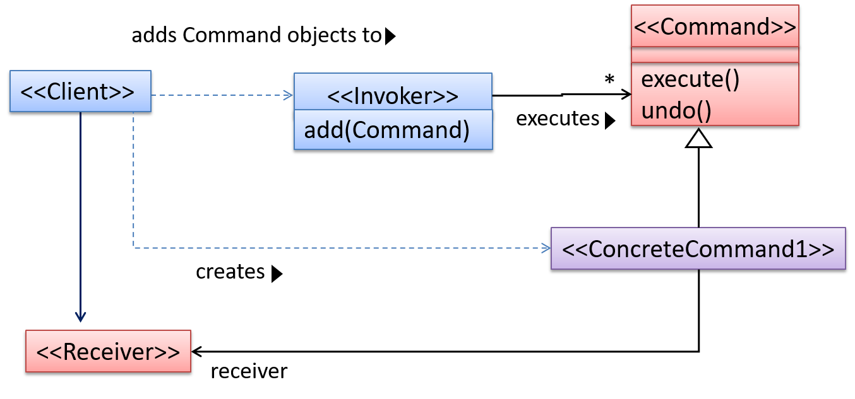
Have a look at the W11-Lecture-exercise.pdf (in Canvas/files) if you haven’t done so already.
CATcher load testing to start after the first few slides
Which of these design patterns are likely to be in the following design?
Façade,
Singleton
Command
Processor
Processor
<<interface>>
Job
Process
*
start()
cancel()
Factory
runs
-instance
-Process()
+add(Job)
+getInstance()
Pull
Push
Fetch
creates
CS2103/T Week 11
[Oct, 2024] [60 + 10 minutes]

Slide 3
Have a look at the W11-Lecture-exercise.pdf (in Canvas/files) if you haven’t done so already.
CATcher load testing to start after the first few slides
Q
1
Which of these design patterns are likely to be in the following design?
Façade,
Singleton
Command
UML stereotype
<< …. >>
Processor
<<facade>>
Processor
<<interface>>
Job
<<singleton>>
Process
*
start()
cancel()
Factory
runs
-instance
-Process()
+add(Job)
+getInstance()
Pull
Push
Fetch
creates

Slide 4
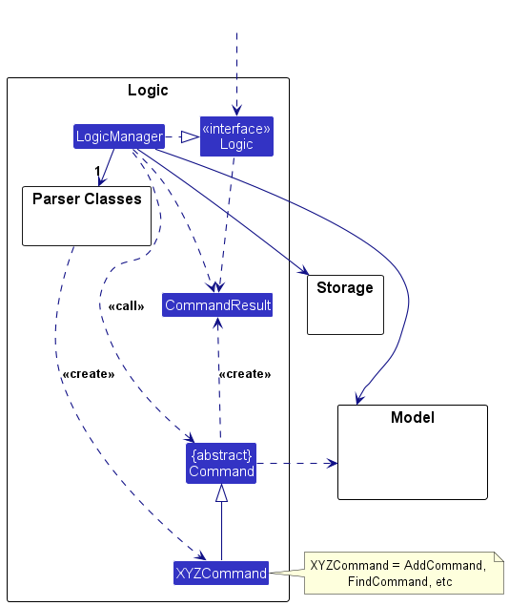

Have a look at the W11-Lecture-exercise.pdf (in Canvas/files) if you haven’t done so already.
CATcher load testing to start after the first few slides
2
Do we have the Command pattern in AB3?
Yes
No

Slide 5
CATcher load/stress test
Objective: Find if the actual PE will break limits in various critical nodes.
Browser downloads code and generates page content dynamically
Why not automate this? Hard to simulate real world circumstances
Free. Can host static pages and client-side logic. No database. No support for server-side logic.
Server generates page content dynamically
All these nodes have specified and unspecified rate limits!
Smoke testing
CATcher Web server (on github.io)
Browser
Browser
GitHub
API
Browser
Free, to store bugs, screenshots etc.
CATcher authentication
server (on Heroku)
Why? To prevent abuse and attacks
Paid. Supports data storage and server-side logic.

Slide 6
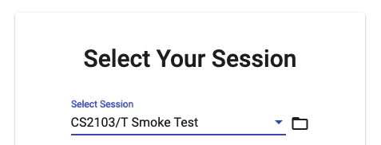
CATcher load/stress test
Go to the CATcher URL tinyurl.com/catcher-web
Choose this session
Login now! Timeout? Refresh and try again. Cannot login? Send me a PM.
Fill in the details for a new (dummy) bug report.
Submit the bug report now!!!. Submit another bug report immediately after.
Done! Thanks for your help. You can leave the Zoom meeting now if you wish (and watch the recording later)
(but don’t login!)
Tick in Zoom after reaching this point.
(but don’t submit!)

Slide 7
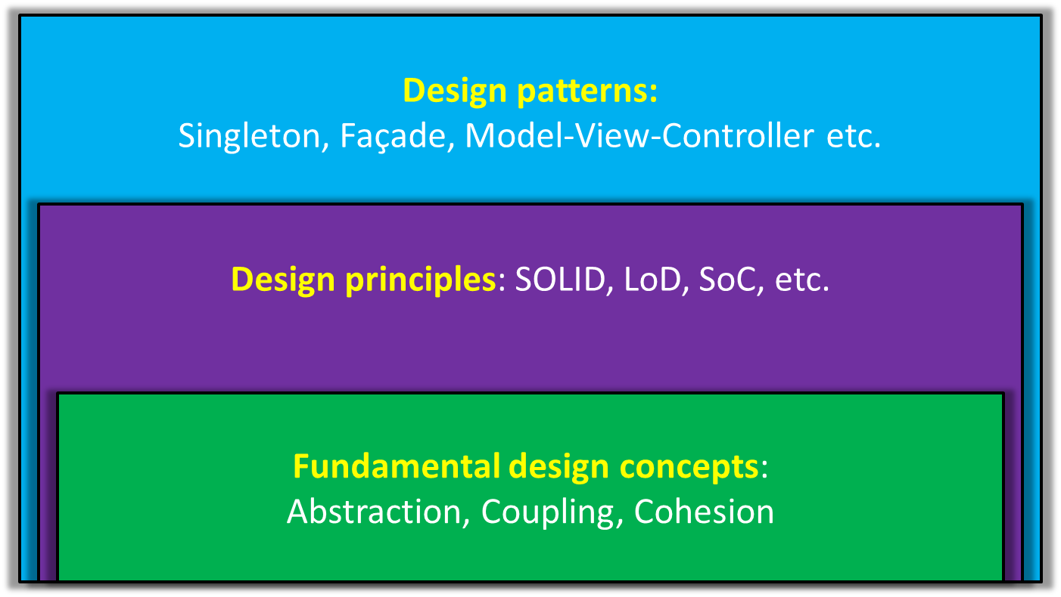
Singleton
Façade
Command
MVC
Observer

Slide 8
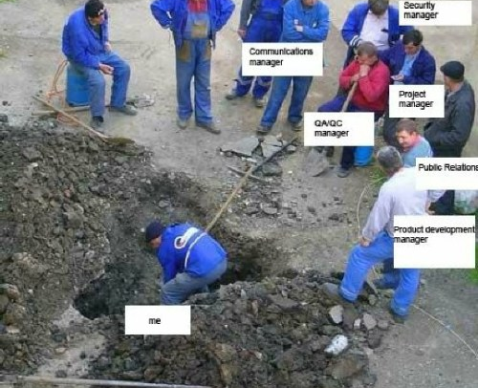
WAITING
WAITING
WAITING
WAITING
WAITING
WAITING
TEAMMATE
WAITING
WAITING
working

Slide 9
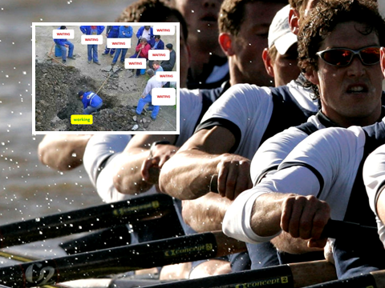
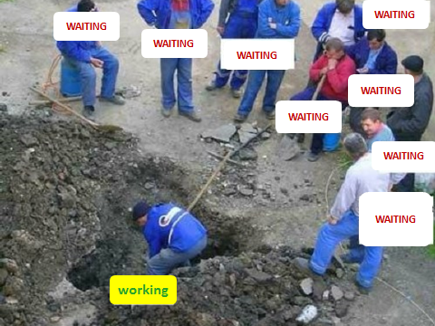


Slide 10

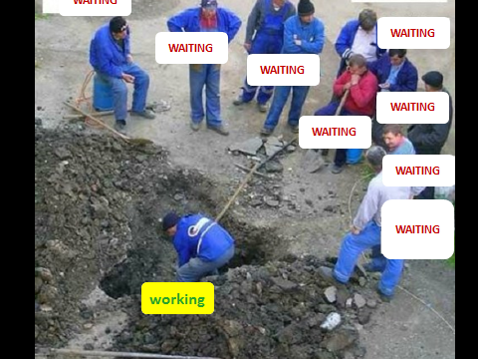

Slide 11
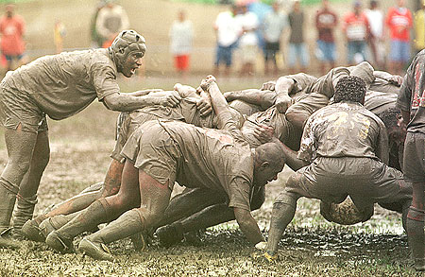

Slide 14
Architecture
+ (important technical decisions)
Designed even before coding;
Should last the product life!
Who designs?

Slide 15
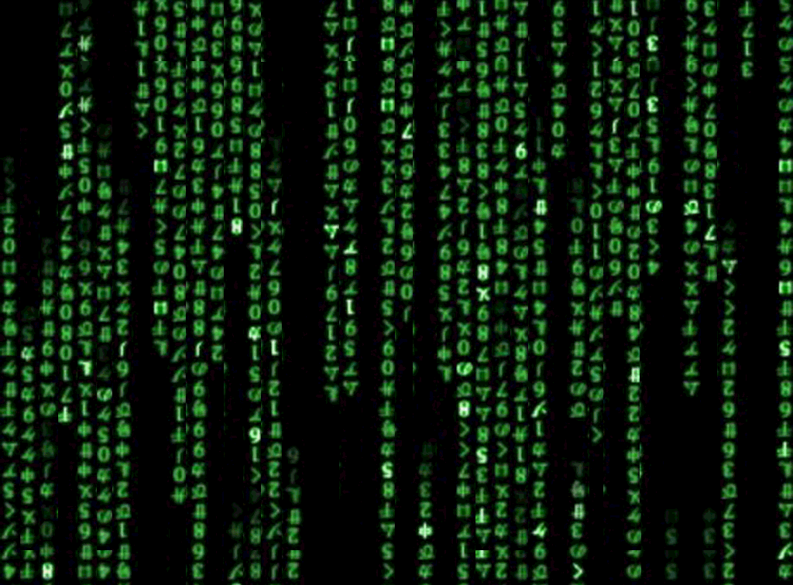
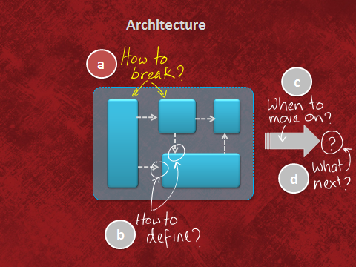
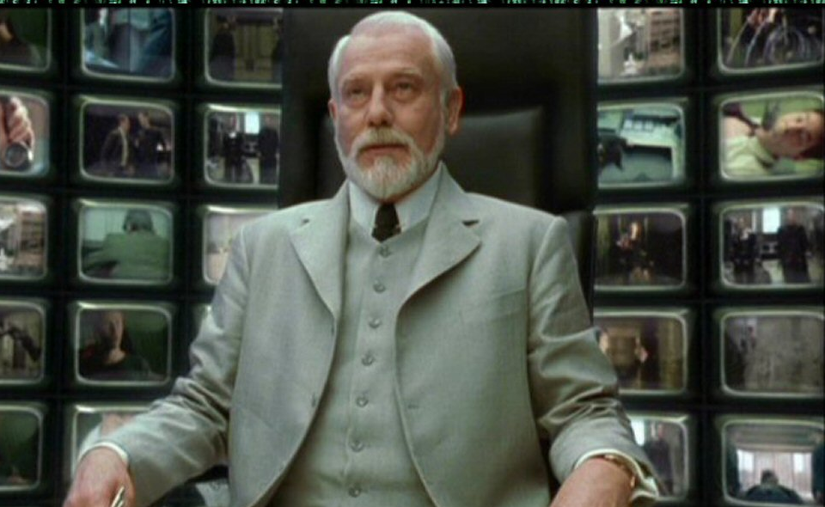

Slide 16

The architect
Notes:
Bill gate once gave up his president post to take over the ‘chief architect’ role.

Slide 17

The architect
Notes:
Bill gate once gave up his president post to take over the ‘chief architect’ role.

Slide 18

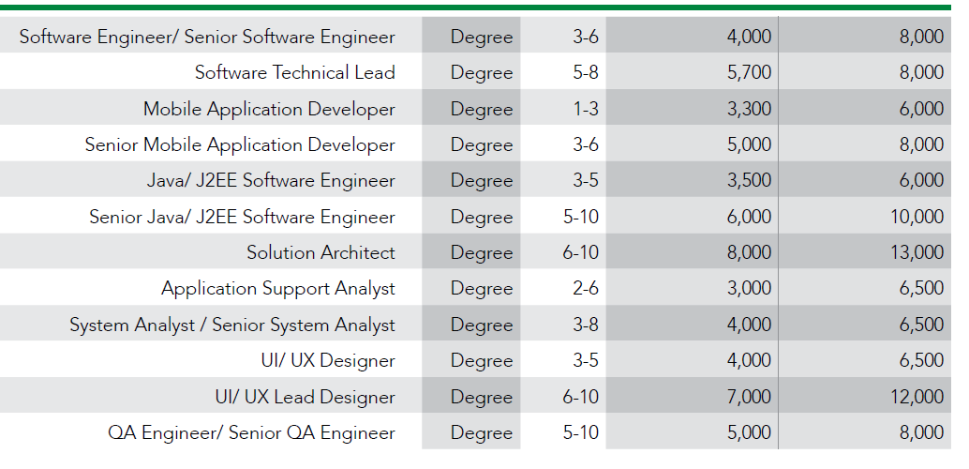
Programming skills not enough!
Ability to see things at a higher level is needed, among other things (e.g., use models).
Not automatic!

Slide 19
Architecture
+ (important technical decisions)
Who designs?
Architect

Slide 21
Similar to an exam question.
3
One of several testing types
Done by users, to check if the product solves their problem
Acceptance testing is most likely to be…
Black box testing
White box testing
Gray box testing
… based on external behavior only
… based on code
… a combination of the other two
Three alternative test case design approaches
This will be half of a 2-minute question (i.e., about 1 minute to answer).

Slide 22

Why choose? →
E&E of testing
How to choose? →
Some heuristics
Test case
Test case
Test case
Test case
Test case
Test case
Test case
Test case
Equivalence partitioning
Boundary value analysis

Slide 23
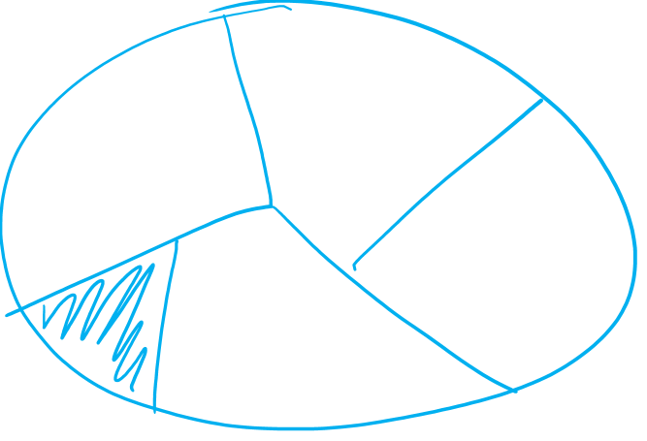
Equivalence partitioning
all possible test inputs
Not necessary to test many cases from one partition
Can ensure all partitions are tested

Slide 24
Equivalence partitioning
increases efficiency of testing
increases effectiveness of testing
Not necessary to test many cases from one partition
Can ensure all partitions are tested
Notes:
Poll Title: The equivalence partitioning technique, https://www.polleverywhere.com/multiple_choice_polls/wFlGATwLxXPZKaoljdtJL?display_state=instructions&activity_state=opened&state=opened&flow=Instructor&onscreen=persist

Slide 25
Does i need more than one eq. partition?
int square (int i)
Description: returns the the square value of i
MIN
-√MAX
-1
+√MAX
MAX
0
Yes
No
Notes:
Poll Title: Does i need more than one eq. partition? https://www.polleverywhere.com/multiple_choice_polls/3TNbBJUKRx151J8DdXTnA?display_state=instructions&activity_state=opened&state=opened&flow=Instructor&onscreen=persist

Slide 26
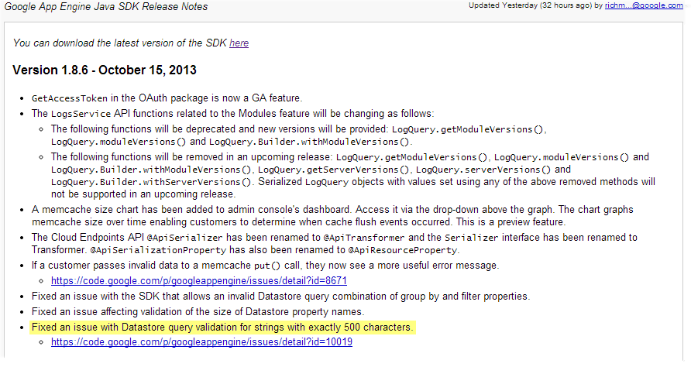
Which heuristic could have prevented this bug?
Boundary value analysis

Slide 27
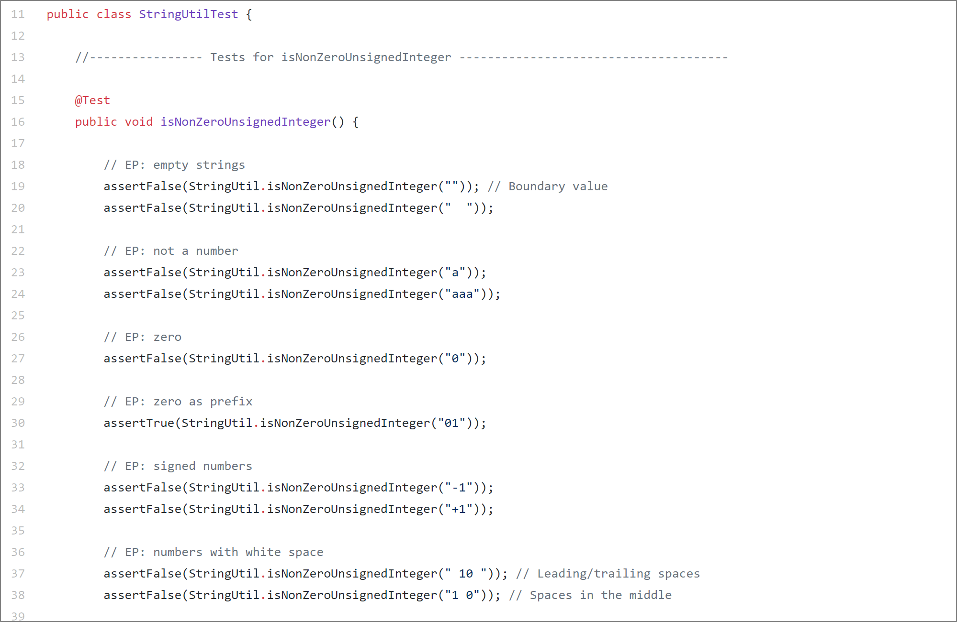
Reason:
For future devs’ reference
For grading

Slide 28
When designing test cases in the tP …
A. apply heuristics when it helps.
B. add comments in test cases to describe how a heuristic was used.
C. every test case must strictly follow these heuristics.
Why?
Heuristics might not apply for some cases.
Heuristics-based test cases might not catch all bugs!

Slide 29
Q3 (a) Design test cases for unit testing the Parser#isValidName method below.
/* Returns true if the name is non-empty and
not null and not longer than 40 chars. */
public static boolean isValidName(String name) {
// ...
}
Equivalence partitions
Values
Test input | Expected
null | false
Test input | Expected
null | False
“ ” | False
Length==41 | False
Length==50 | False
Length==40 | True
Length==1 | True
Non-Strings?
null
null
Strings with spaces at start/end?
Special chars?
empty
“ ”
“”
too long
length = 41
, 50
right size
40, 1, 10

Slide 30
Q3 (a) Design test cases for unit testing the Parser#isValidName method below.
/* Returns true if the name is non-empty and
not null and not longer than 40 chars. */
public static boolean isValidName(String name) {
// ...
}
Test input | Expected
5 (int) | -
Equivalence partitions
Values
[ ]
[ ]
[ ]
[ ]
[ ]
[ ]
[ ]
Test input | Expected
null | false
Test input | Expected
null | False
“ ” | False
Length==41 | False
Length==50 | False
Length==40 | True
Length==1 | True
null
null
empty
“ ”
too long
length = 41
, 50
right size
40, 1

Slide 31
/* Throws StorageException if name is not valid
or if name already exists in the database. */
public void saveScore(String name)
throws StorageException {
if (!Parser.isValidName(name)) {
throw new StorageException("invalid name");
}
if (storage.isFound(name)) {
throw new StorageException("already exists");
}
storage.save(name);
}
How do we unit test this method?
If Unit testing , we should use stubs for dependencies isValidName etc.

Slide 32
/* Throws StorageException if name is not valid
or if name already exists in the database. */
public void saveScore(String name)
throws StorageException {
if (!Parser.isValidName(name)) {
throw new StorageException("invalid name");
}
if (storage.isFound(name)) {
throw new StorageException("already exists");
}
storage.save(name);
}
(b) Design integration test cases for the method below. Note that it uses the method given in (a).
Use all these test cases too?
Integration tests are choreography tests. They do not test components. They test how well the assembly of components dance together.
Test input | Expected
null | False
“ ” | False
Length==41 | False
Length==50 | False
Length==40 | True
Length==1 | True

Slide 33
/* Throws StorageException if name is not valid
or if name already exists in the database. */
public void saveScore(String name)
throws StorageException {
if (!Parser.isValidName(name)) {
throw new StorageException("invalid name");
}
//more code (does not involve dependencies)
if (storage.isFound(name)) {
throw new StorageException("already exists");
}
//more code (does not involve dependencies)
storage.save(name);
}
(b) Design integration test cases for the method below. Note that it uses the method given in (a).
To be tested by unit tests
Test input | Expected
“new guy” | success
null | exception
“existing guy” | exception
Eq. partitions
Values
invalid
Any invalid e.g. null
exists
Any existing name e.g. “existing guy”
new
Any valid new name e.g. “new guy”

Slide 34
/* Throws StorageException if name is not valid
or if name already exists in the database. */
public void saveScore(String name)
throws StorageException {
if (!Parser.isValidName(name)) {
throw new StorageException("invalid name");
}
if (storage.isFound(name)) {
throw new StorageException("already exists");
}
storage.save(name);
}
(b) [2 marks] Design integration test cases for the method below. Note that it uses the method given in (a).
How many test cases?
2
3
4
5
Test input | Expected
“new guy” | success
null | exception
“existing guy” | exception
Eq. partitions
Values
invalid
Any invalid e.g. null
exists
Any existing name e.g. “existing guy”
new
Any valid new name e.g. “new guy”

Slide 35


/* Throws StorageException if name is not valid
or if name already exists in the database. */
public void saveScore(String name)
throws StorageException {
if (!Parser.isValidName(name)) {
throw new StorageException("invalid name");
}
if (storage.isFound(name)) {
throw new StorageException("already exists");
}
storage.save(name);
}
Test input | Expected
“new guy” | success
null | exception
“existing guy” | exception
Do we really need to test this method?
Short and simple methods

Slide 36
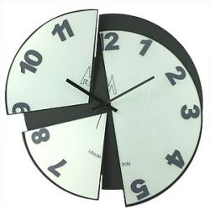
/* Throws StorageException if name is not valid
or if name already exists in the database. */
public void saveScore(String name)
throws StorageException {
if (!Parser.isValidName(name)) {
throw new StorageException("invalid name");
}
if (storage.isFound(name)) {
throw new StorageException("already exists");
}
storage.save(name);
}
Test input | Expected
“new guy” | success
null | exception
“existing guy” | exception
Do we really need to test this method?
Even a stopped clock looks correct twice a day!
Notes:
Even a broken clock looks as if it’s working twice a day. Just because the code looks right doesn’t mean it is right. Test anyway.

Slide 37
/* Throws StorageException if name is not valid
or if name already exists in the database. */
public void saveScore(String name)
throws StorageException {
if (!Parser.isValidName(name)) {
throw new StorageException("invalid name");
}
if (storage.isFound(name)) {
throw new StorageException("already exists");
}
storage.save(name);
}
Test input | Expected
“new guy” | success
null | exception
“existing guy” | exception
Do we really need to test this method?
Yes we must.
No need. Too trivial.
Good to, if not too costly.
Notes:
Even a broken clock looks as if it’s working twice a day. Just because the code looks right doesn’t mean it is right. Test anyway.

Slide 38
Why choose? →
E&E of testing
How to choose? →
Some heuristics
Test case
Test case
Test case
Test case
Test case
Test case
Test case
Test case
Equivalence partitioning
Boundary value analysis
Combining multiple inputs
What if there are multiple inputs to the SUT?

Slide 40
Q2. Suggest at least 5 ways (no more than 2 related to the coding standard) to improve the quality of the following code.
1
2
3
4
5
6
7
8
9
10
11
12
/* Set user as ‘active’ on the server. * @throws CannotActivateException if the user doesn’t exist on the server
*/
void activateUserOnServer(String userName) throws CannotActivateException{
log("trying to activate");
assert isUsernameAcceptable(userName);
ServerConnection.activate(userName);
if(!ServerConnection.isActivated(userName))
throw new CannotActivateException(userName + " not activated");
Account account = AccountManager.getAccount(userName);
account.toggleActivatedStatus(); //mark as activated
}
Notes:
Coding standard:
line1: Set -> Sets
Line 8: missing braces
Logging:
line 5: This is not a good log message. It should contain more info e.g. value of the parameter
Assertions:
line 6: If assertions are enabled and the user name is invalid, this line will cause the execution to halt
line 6: This line makes an assumption that is not documented in the header comment
Exceptions:
lines 7-9: This problem should be handled using an assertion, not an exception?
lines 7-9: This behavior does not match the advertised behavior of the method
Coupling and cohesion:
lines 10-11: This reduces the cohesion of the method
lines 10-11: This increases the coupling of the method
lines 10-11: Behavior not mentioned in the header comment
Defensive coding:
line 11: this line is not defensive

Slide 41
Fixing coding standard violations:
1
2
3
4
5
6
7
8
9
10
11
12
/* Set user as ‘active’ on the server. * @throws CannotActivateException if the user doesn’t exist on the server
*/
void activateUserOnServer(String userName) throws CannotActivateException{
log("trying to activate");
assert isUsernameAcceptable(userName);
ServerConnection.activate(userName);
if(!ServerConnection.isActivated(userName))
throw new CannotActivateException(userName + " not activated");
Account account = AccountManager.getAccount(userName);
account.toggleActivatedStatus(); //mark as activated
}
(a) Line 1: /* → /**
(b) Line 1: Set → Sets
(c) Line 4: Add missing visibility
(d) Line 5: The log message can be more descriptive
(e) Line 8: Add missing braces
x
x

Slide 42
Any problems w.r.t. assertions, exceptions?
1
2
3
4
5
6
7
8
9
10
11
12
/* Set user as ‘active’ on the server. * @throws CannotActivateException if the user doesn’t exist on the server
*/
void activateUserOnServer(String userName) throws CannotActivateException{
log("trying to activate");
assert isUsernameAcceptable(userName);
ServerConnection.activate(userName);
if(!ServerConnection.isActivated(userName))
throw new CannotActivateException(userName + " not activated");
Account account = AccountManager.getAccount(userName);
account.toggleActivatedStatus(); //mark as activated
}
(a) Line 6: Undocumented assumption or should use an exception
(b) Line 7-9: Behavior doesn’t match the advertised behavior

Slide 43
Any problems w.r.t. coupling and cohesion?
1
2
3
4
5
6
7
8
9
10
11
12
/* Set user as ‘active’ on the server. * @throws CannotActivateException if the user doesn’t exist on the server
*/
void activateUserOnServer(String userName) throws CannotActivateException{
log("trying to activate");
assert isUsernameAcceptable(userName);
ServerConnection.activate(userName);
if(!ServerConnection.isActivated(userName))
throw new CannotActivateException(userName + " not activated");
Account account = AccountManager.getAccount(userName);
account.toggleActivatedStatus(); //mark as activated
}
(a) Lines 10-11: Reduces cohesion
(b) Lines 10-11: Increases coupling
(c) Lines 10-11: Behavior not advertised (hidden behavior)
x

Slide 44
Any further problems w.r.t. defensive coding?
1
2
3
4
5
6
7
8
9
10
11
12
/* Set user as ‘active’ on the server. * @throws CannotActivateException if the user doesn’t exist on the server
*/
void activateUserOnServer(String userName) throws CannotActivateException{
log("trying to activate");
assert isUsernameAcceptable(userName);
ServerConnection.activate(userName);
if(!ServerConnection.isActivated(userName))
throw new CannotActivateException(userName + " not activated");
Account account = AccountManager.getAccount(userName);
account.toggleActivatedStatus(); //mark as activated
}
(a) Line 6: Not defensive
(b) Line 11: Not defensive
x

Slide 45
Whoa! So many things to consider in so little code!
1
2
3
4
5
6
7
8
9
10
11
12
/* Set user as ‘active’ on the server. * @throws CannotActivateException if the user doesn’t exist on the server
*/
void activateUserOnServer(String userName) throws CannotActivateException{
log("trying to activate");
assert isUsernameAcceptable(userName);
ServerConnection.activate(userName);
if(!ServerConnection.isActivated(userName))
throw new CannotActivateException(userName + " not activated");
Account account = AccountManager.getAccount(userName);
account.toggleActivatedStatus(); //mark as activated
}
It’s OK if you didn’t think of all those code quality problems.
Some are not obvious, some are subjective.
There may be others not mentioned.
Good enough if you were able to understand the discussion.

Slide 46
QA
Testing
Code reviews
Static analysis
Formal methods

Slide 47

blah framework blah platform blah blah blah cloud blah blah blah …
What a load of bull crap …

Slide 50
There is an extra week!

